Slide 1
Healthcare Analytics using SQL
Objective: To extract meaningful insights about patients, doctors, and treatments using advanced SQL techniques to improve healthcare management.
Key Focus: Data integrity, relationship mapping, and clinical reporting.
Presented by: N Elangovan
BMAI-C-WD-E-B16

Slide 2
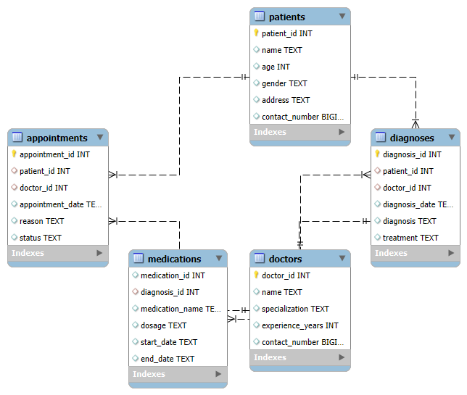
Database Architecture
Patients Table: Core demographic and medical history data.
Doctors Table: Information on specializations and expertise.
Appointments & Diagnoses & Medications
Tracking patient visits and medical conditions
Integrity: Verified through Primary Keys and Foreign Keys to ensure data consistency across the schema.

Slide 3
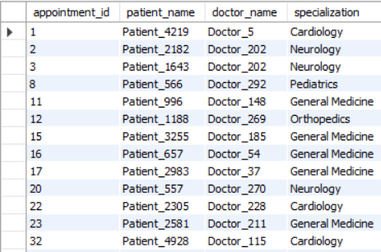
1. Patient Appointments Analytics
Objective:
To retrieve comprehensive details of all completed appointments by integrating data from multiple sources.
To link patient demographics with clinical staff specializations for operational reporting.
Technical Concept:
Inner Join: Utilized to fetch only the matching records where both a patient and a corresponding appointment exist.
Equi Join: Implemented to establish a direct relationship between Patient ID and Doctor ID across tables.
Insights:
Data Mapping: The result successfully maps specific patients and their medical departments.
Specialization Trends: High appointment volumes are observed in departments like Cardiology, Neurology, and General Medicine.
System Accuracy: The clean output grid confirms that the database maintains high data integrity with no orphaned appointment records.

Slide 4
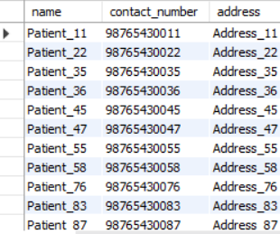
2. UNREGISTERED PATIENT DISCOVERY
Objective:
To extract their contact and address details for hospital outreach or follow-up programs.
To identify patients who have registered in the database but have never had an appointment recorded.
Technical Concept:
Left Join: Used to combine the Patients and Appointments tables, ensuring all patients are listed regardless of whether they have a matching appointment.
IS NULL Filtering: Specifically applied to filter out patients where the Appointment ID is missing, effectively isolating those with zero visits.
Insights:
Outreach Potential: The result identifies specific individuals (e.g., Patient_11, Patient_22) who represent a "Lost Lead" or "Inactive Patient" category.
Data Privacy & Marketing: By having direct access to their contact numbers and addresses, the hospital can initiate targeted check-up reminders or promotional health camp notifications.
Database Maintenance: This list helps in cleaning the database by identifying records that may have been created accidentally or remain unused for long periods.

Slide 5
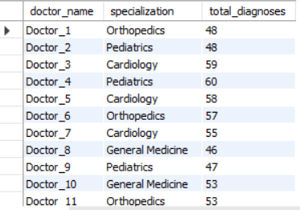
3. DOCTOR DIAGNOSTIC PERFORMANCE
Objective:
To measure clinical activity by counting the total number of diagnoses provided by each doctor.
To ensure a complete performance audit by listing all doctors, regardless of their current diagnosis volume.
Technical Concept:
Right Join: Applied to ensure all records from the Doctors table are included, even if they have no corresponding entries in the Diagnoses table.
Aggregate COUNT(): Used to summarize diagnostic data per physician for productivity analysis.
Insights:
High-Volume Performers: Doctors like Doctor_4 (Pediatrics) and Doctor_3 (Cardiology) show the highest diagnostic activity with 60 and 59 diagnoses respectively, indicating high patient turnover in these departments.
Balanced Workload: Most specialists (Orthopedics, Pediatrics, Cardiology) maintain a consistent volume between 46 to 60 diagnoses, showing a well-distributed clinical workload across the hospital.
Departmental Efficiency: The data confirms that Pediatrics and Cardiology are currently the most active departments, which helps management in allocating more nursing staff or equipment to these areas.

Slide 6
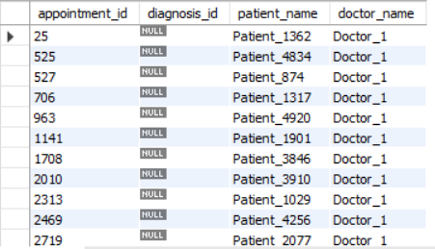
4. CROSS-DEPARTMENTAL RELATIONSHIP MAPPING
Objective:
To perform a comprehensive audit of the relationship between patients and their clinical records.
To ensure every record is accounted for, specifically identifying appointments that lack an associated diagnosis.
Technical Concept:
Full Outer Join: This operation is designed to combine the results of both Left and Right joins to show a "Complete Picture" of the database relationships.
Data Integrity Audit: By joining Appointments with Diagnoses, we can pinpoint missing links in the patient treatment cycle.
Insights:
Clinical Documentation Gap: The result grid shows multiple appointments (e.g., ID 25, 525, 527) for Doctor_1 where the diagnosis_id is NULL. This indicates a significant gap in clinical documentation.
Operational Follow-up: These "NULL" records flag patients who attended an appointment but do not have a recorded diagnosis or treatment plan in the system yet.
Physician Accountability: Specifically, Doctor_1 has several pending diagnostic entries. Management can use this data to request the physician to update pending medical records for better patient care continuity.

Slide 7
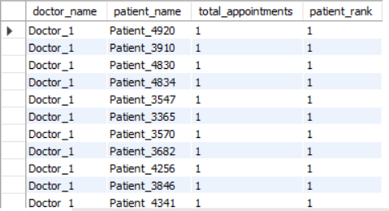
5. PATIENT VISIT RANKING
Objective:
To assign a priority rank to patients based on their total number of appointments with each specific doctor.
To identify high-frequency visitors who may require long-term chronic care management.
Technical Concept:
Window Function (DENSE_RANK): Implemented to rank patients without gaps in the ranking sequence, ensuring that patients with the same visit count receive the same rank.
PARTITION BY Clause: Used to reset the ranking logic for each Doctor ID, allowing for a localized analysis of patient loyalty per physician.
Insights:
Patient Frequency Analysis: The result grid shows that for Doctor_1, multiple patients (e.g., Patient_4920, Patient_3910) share Rank 1 with 1 appointment each. In a larger dataset, this helps identify the most frequent visitors for prioritized scheduling.
Continuity of Care: By identifying "Rank 1" patients, the hospital can flag individuals who consistently see the same specialist, which is a key indicator of patient trust and effective treatment outcomes.
Administrative Load: Doctors with a high volume of "Rank 1" patients (with high visit counts) can be assigned additional clinical support to manage their recurring patient load efficiently.

Slide 8
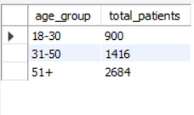
6. PATIENT DEMOGRAPHIC SEGMENTATION
Objective:
To categorize the patient database into specific age groups (18-30, 31-50, and 51+) for better clinical trend analysis.
To provide the hospital management with a clear distribution of the patient population.
Technical Concept:
Conditional Logic (CASE Statement): Used to evaluate the age column and assign a descriptive label based on predefined numerical ranges.
Grouping & Aggregation: Combined the CASE logic with COUNT(*) and GROUP BY to summarize the total volume of patients in each segment.
Insights:
Dominant Senior Population: The 51+ age group is the largest segment with 2,684 patients, indicating a high demand for geriatric care, chronic disease management, and specialized screenings.
Secondary Market: The 31-50 age group follows with 1,416 patients, representing the working-class demographic that may require preventive health packages or occupational therapy.
Targeted Health Programs: With only 900 patients in the 18-30 group, the hospital can launch awareness campaigns or "Young Adult" wellness programs to increase registration and engagement in this demographic.

Slide 9
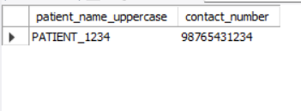
7. ADVANCED DATA STANDARDIZATION
Objective:
To standardize patient naming conventions for uniform reporting and clinical documentation.
To extract specific contact records based on numerical patterns for targeted verification.
Technical Concept:
String Transformation (UPPER): Applied to the patient_name column to ensure all records are displayed in uppercase, eliminating inconsistencies caused by manual data entry.
Pattern Matching (LIKE): Utilized the %1234 wildcard pattern to filter patients whose contact numbers end with specific digits, demonstrating precise data retrieval capabilities.
Insights:
Data Uniformity: By transforming "Patient_1234" to "PATIENT_1234", the system ensures that search results and medical IDs are professional and easy to read across all hospital departments.
Targeted Search Efficiency: The ability to filter by contact number patterns is crucial for resolving duplicate records or finding specific patient groups when names are unknown but partial contact details are available.
Reporting Readiness: Standardized data prevents errors in automated reporting tools, ensuring that clinical audits have 100% accurate and consistent naming formats.

Slide 10
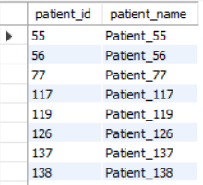
8. SPECIALIZED MEDICATION FILTERING
Objective:
To isolate a specific cohort of patients who have been prescribed "Insulin" for targeted diabetic care management.
To demonstrate the use of nested queries to filter data based on clinical records from the Medications table.
Technical Concept:
Subquery (IN Clause): Implemented a subquery to first identify all Patient IDs associated with "Insulin" in the medications table, then used the outer query to fetch their full profile.
Relational Filtering: This approach efficiently connects demographic data with specific treatment history without requiring a complex multi-table join for simple filtering.
Insights:
Diabetic Cohort Identification: The result successfully identifies a specific group (e.g., Patient_55, Patient_56, Patient_77) that requires specialized diabetic monitoring and insulin supplies.
Pharmacy Stock Optimization: By knowing the exact number of patients on Insulin, the hospital pharmacy can optimize its inventory levels to ensure no stock-outs for this life-saving medication.
Targeted Clinical Trials: This list provides a ready-made database for doctors looking to enroll patients in new diabetic research programs or specialized dietary workshops.

Slide 11
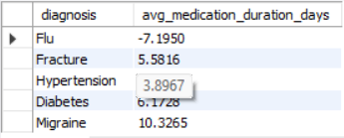
9. MEDICATION DURATION ANALYSIS
Objective:
To calculate the average duration of treatment prescribed for various medical conditions.
To provide data-driven insights into recovery timelines for different diagnoses.
Technical Concept:
Date Arithmetic (DATEDIFF): Utilized to calculate the number of days between the start_date and end_date for each medication record.
Aggregated Averaging (AVG): Combined with GROUP BY to determine the mean treatment length for each specific diagnosis.
Insights:
Long-Term Care Trends: Migraine treatments show the highest average duration of 10.3 days, suggesting that these patients require more extended pharmaceutical support compared to other conditions.
Chronic vs. Acute: Conditions like Diabetes (6.1 days) and Hypertension (3.8 days) show consistent treatment windows, assisting the pharmacy in predictable stock replenishment.
Data Quality Observation: The result for Flu (-7.1 days) indicates a potential data entry anomaly where the end date was recorded before the start date.

Slide 12
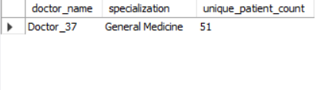
10. PHYSICIAN IMPACT & PATIENT REACH
Objective:
To identify the doctor who has attended the highest number of unique patients.
To measure the clinical reach and diversity of the medical staff's patient base.
Technical Concept:
Complex Joins: Integrated Doctors and Appointments tables to link physician profiles with patient visits.
COUNT(DISTINCT): Utilized this specific aggregate function to ensure that multiple visits by the same patient are only counted once, giving an accurate measure of "Unique Reach."
Limit/Ranking: Used to isolate the top-performing physician based on the calculated patient volume.
Insights:
Top Performer: Doctor_37 (General Medicine) emerged as the physician with the highest reach, attending to 51 unique patients.
Departmental Lead: This confirms that the General Medicine department acts as the primary entry point for the hospital, handling a diverse and large volume of individuals.
Strategic Resource Allocation: Identifying high-reach doctors helps management understand which specialists are most critical for hospital-wide patient satisfaction and clinical reputation.

Slide 13
PROJECT CONCLUSION & KEY FINDINGS
Summary of Clinical Insights:
Operational Gaps: The data audit successfully identified critical gaps in clinical documentation, specifically highlighting appointments lacking associated diagnoses.
Patient Engagement: Through the "Unregistered Patient Discovery" task, we isolated "Lost Leads"—patients who registered but never visited—providing a clear list for hospital outreach programs.
Performance Excellence: The analysis identified Doctor_37 as the physician with the highest patient reach (51 unique patients), indicating high efficiency in the General Medicine department.
Technical Achievement:
Advanced Querying: Successfully demonstrated the use of complex SQL tools including DENSE_RANK() for patient loyalty and Subqueries for targeted medication analysis.
Data Quality Management: Identified data entry anomalies (e.g., negative treatment durations for Flu) that highlight the need for better front-end validation rules.

Slide 14
FUTURE ENHANCEMENTS
To further evolve this Hospital Management System, the following steps are proposed:
Predictive Analytics: Integrating Machine Learning models to predict patient "No-Show" rates based on historical appointment patterns.
Automated Dashboards: Connecting the SQL database to Power BI or Tableau to create real-time visualizations for hospital administrators to track doctor workload instantly.
Patient Portal Integration: Expanding the database to support a patient-facing portal where individuals can view their standardized medication history and diagnoses.
Enhanced Security: Implementing Role-Based Access Control (RBAC) to ensure that sensitive patient demographics are only accessible to authorized medical staff.

Slide 15
Thank you

